Slide 1
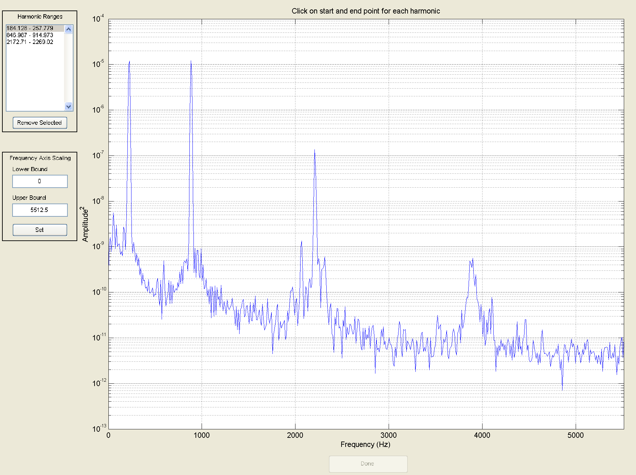
Harmonic Analysis of Mallet Percussion
By Max Candocia

Slide 2
Goals
Basic understanding of sound waves and mallet percussion
Understand harmonic analysis
Understand difference in sounds of different mallets and striking location
Notes:
Emphasize harmonics

Slide 3

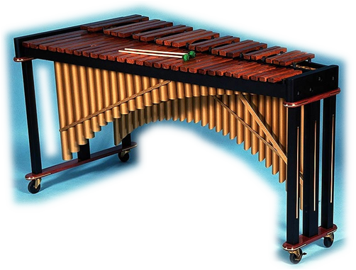
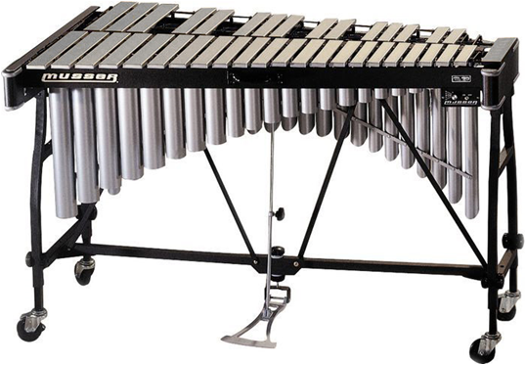
Marimba
Vibraphone
Recording: Vermont Counterpoint, Nathaniel Bartlett
Recording: La Fille Aux Cheveux de Lin, Ozone Percussion Ensemble
Photo courtesy of vichitex.com
Photo courtesy of woodbrass.com

Slide 4
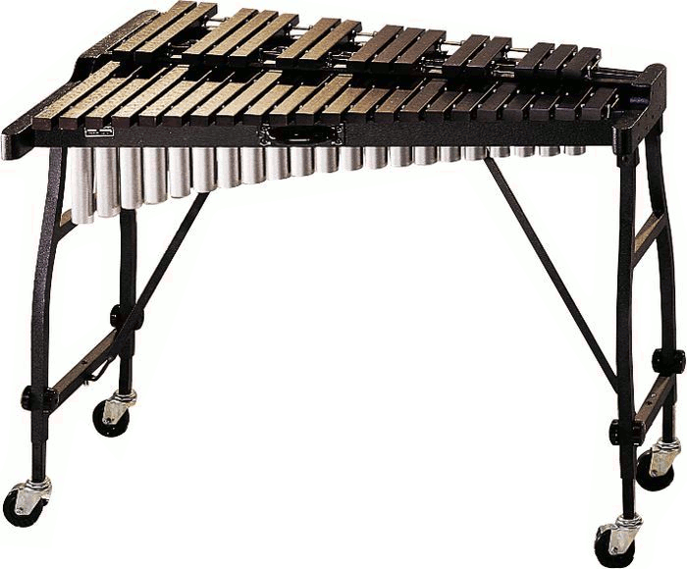
Xylophone
Recording: Fantasy on Japanese Wood Prints
Photo courtesy of onlinerock.com

Slide 5
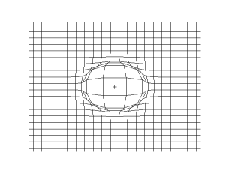
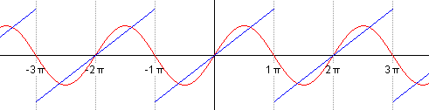
Sound Waves
Vibrating medium (ie. Air, water, ground)
Longitudinal
Harmonics
  Sinusoidal Components
Sine:
Sawtooth:
Images courtesy of Wikipedia

Slide 6
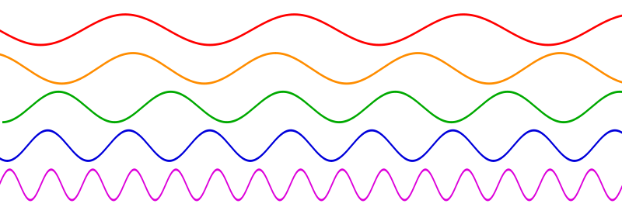
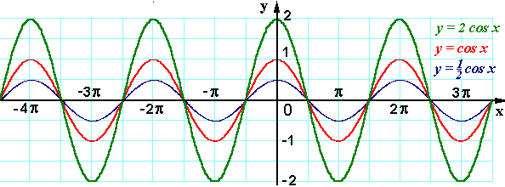
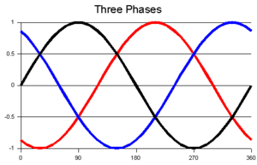
Qualities of Harmonics
Frequency
  Cycles per second (Hertz);
  determines pitch
Amplitude
  Power of wave; determines
  loudness
Phase
  Location of harmonic relative
  to other harmonics
Photo courtesy of Wikipedia
Photo courtesy of physics.cornell.edu
Photo courtesy of 3phasepower.org
Notes:
Might go back a slide to show synthesis of sawtooth wave

Slide 7
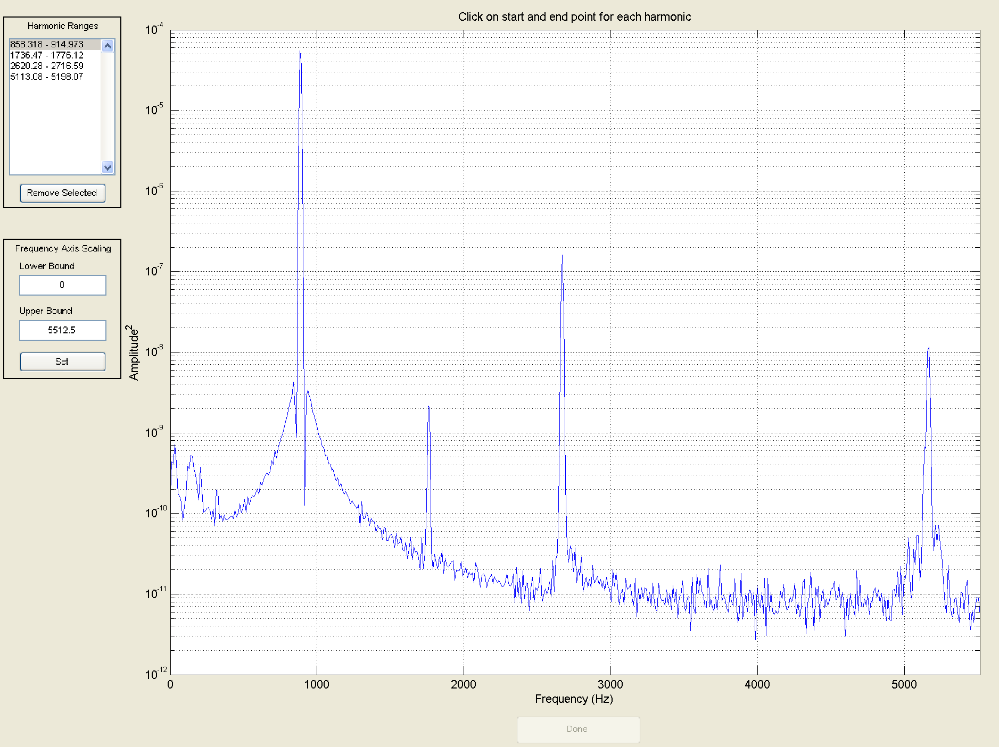
Harmonic Analysis
Harmonics of Kelon xylophone struck in center with hard rubber mallet
Notes:
Sounds are near respective harmonics on graphs; full sound is at top

Slide 8
Vibraphone Harmonics
Dry:
Wet:
Instrument | Mallet | Location | # Harmonics | H1 dB | H2 dB | H3 dB | H4 dB | H5 dB
Vibraphone | Black | Dry | 5 | 6 | 19 | 0.8 | 13 | 3
Vibraphone | Black | Wet | 2 | 16 | 1.1
Vibraphone | Red | Dry | 3 | 22 | 3.5 | 1.5
Vibraphone | Red | Wet | 1 | 1
Vibraphone | White | Dry | 4 | 16 | 0.5 | 9 | 0.6
Vibraphone | White | Wet | 2 | 25 | 1.5
Notes:
Sounds are with black mallet on vibes

Slide 9
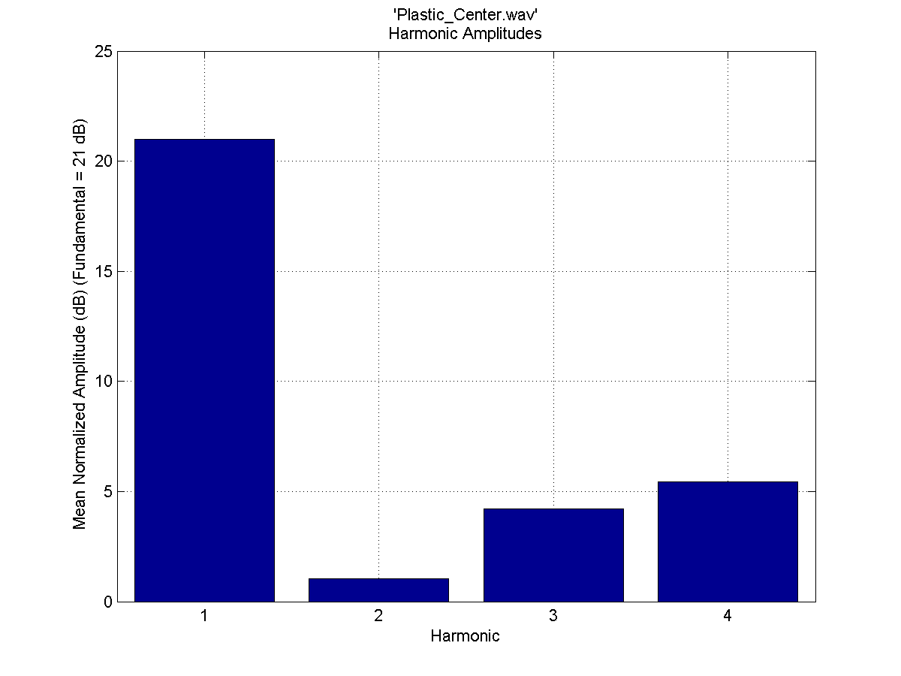
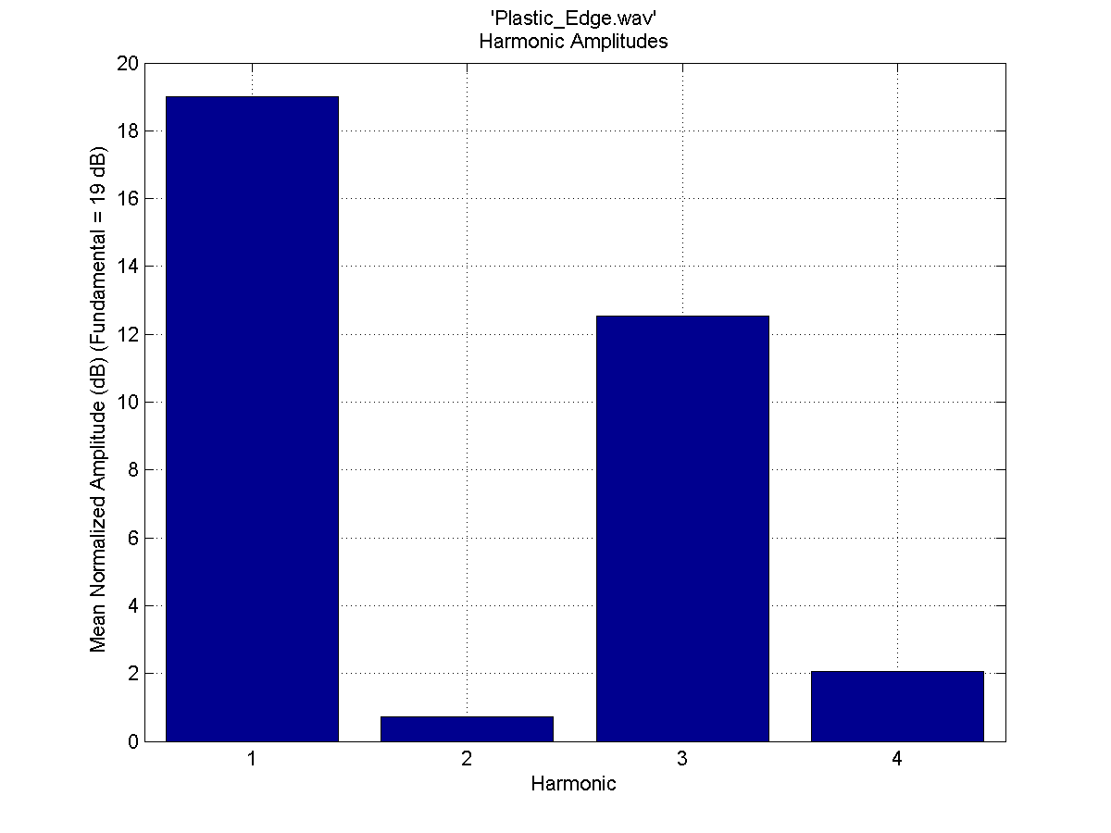
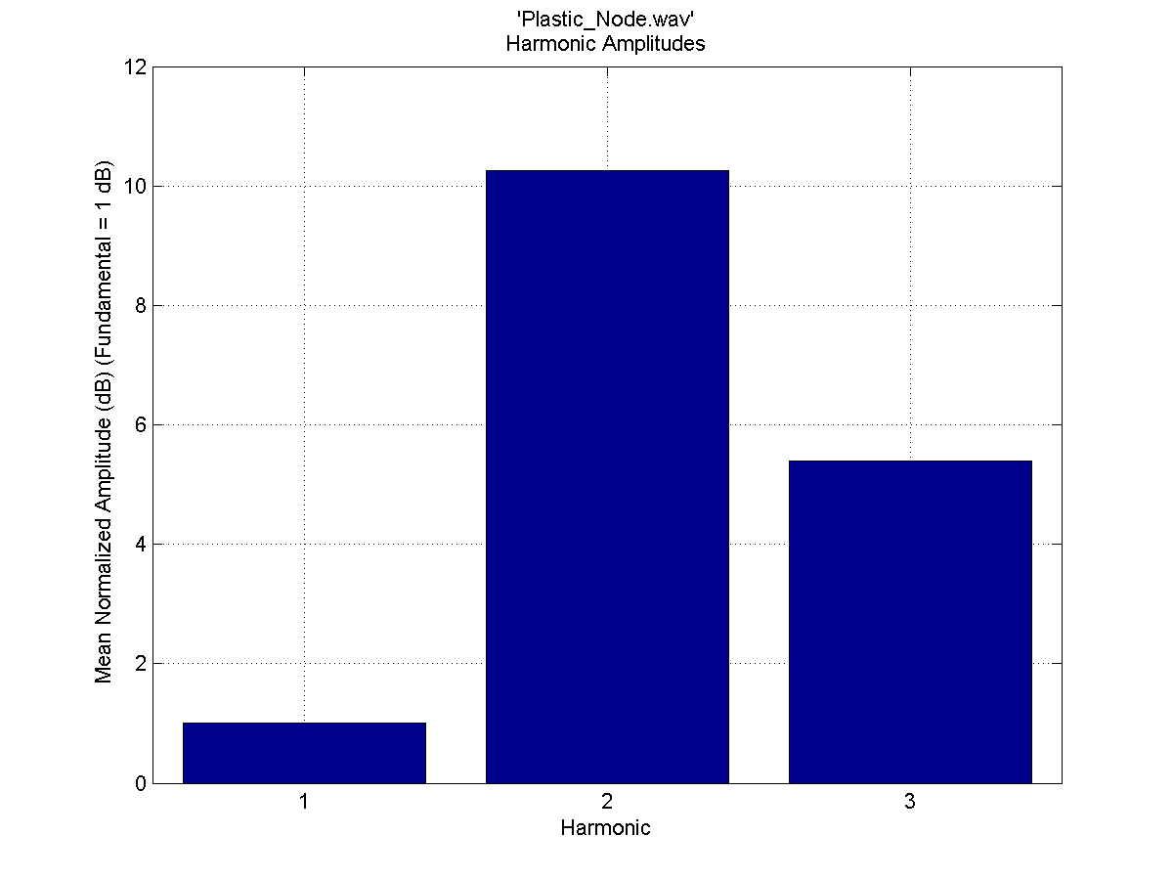
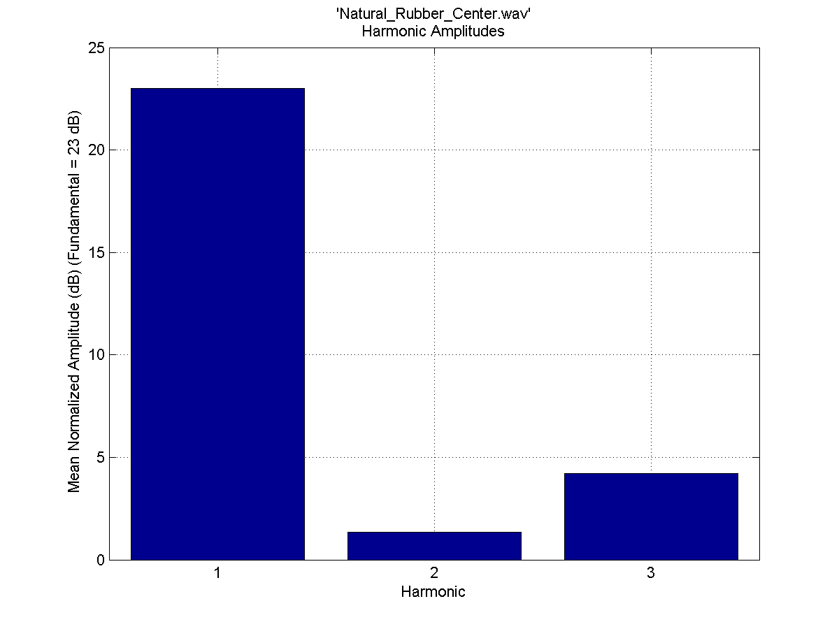
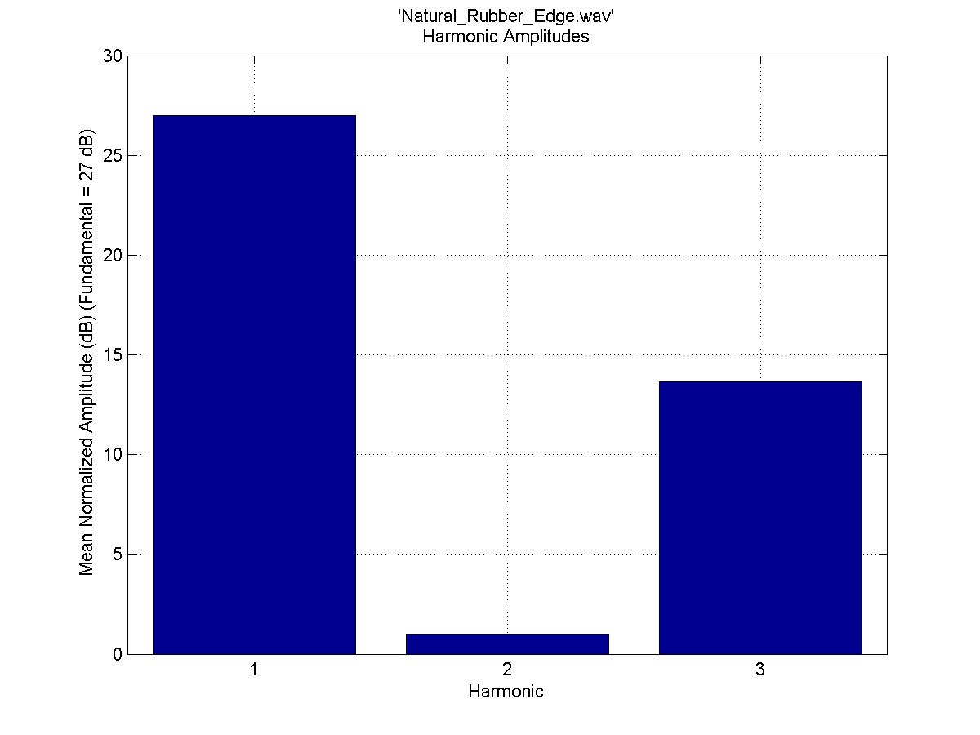
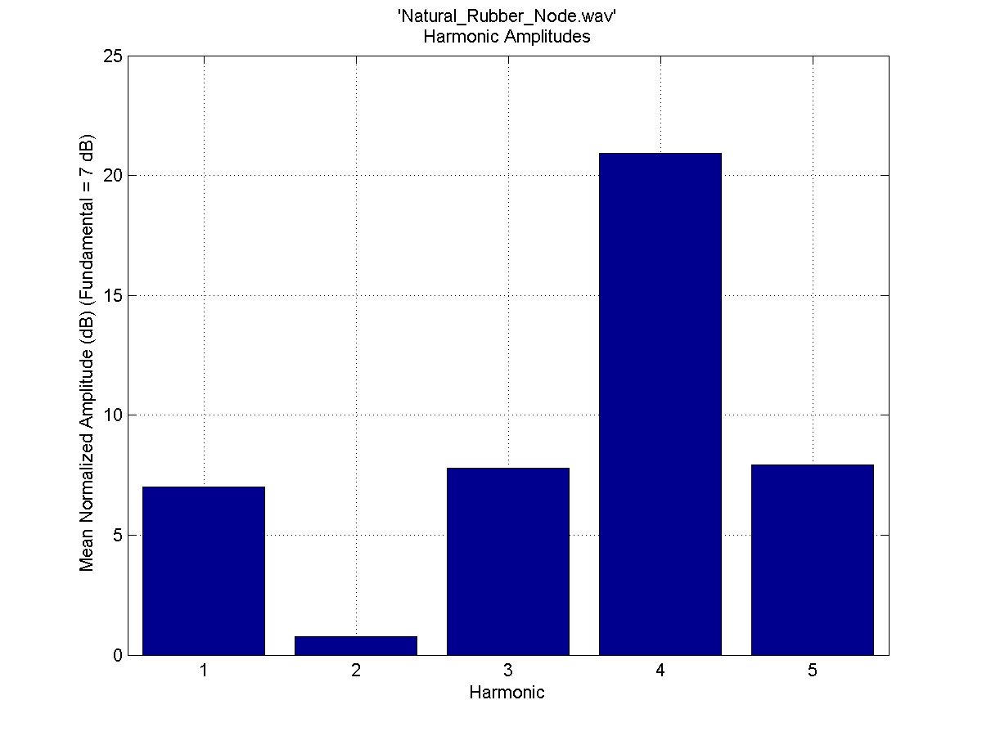
Xylophone Harmonics
Instrument | Mallet | Location | # Harmonics | H1 Freq | H2 Freq | H3 Freq | H4 Freq | H5 Freq
Xylophone | Hard Rubber | Center | 4 | 886.9 | 1750 | 2670 | 5100
Xylophone | Hard Rubber | Edge | 4 | 886.9 | 1760 | 2670 | 5150
Xylophone | Hard Rubber | Node | 3 | 886.85 | 2670.5 | 5155
Xylophone | Natural Rubber | Center | 3 | 886.9 | 1750 | 2670
Xylophone | Natural Rubber | Edge | 3 | 886.95 | 1760 | 2670
Xylophone | Natural Rubber | Node | 5 | 887 | 1759 | 2167 | 2670.5 | 5150
Xylophone | Plastic | Center | 4 | 886.9 | 1750 | 2670 | 5100
Xylophone | Plastic | Edge | 4 | 886.95 | 1760 | 2670 | 5170
Xylophone | Plastic | Node | 3 | 886.85 | 2670.5 | 5200

Slide 10
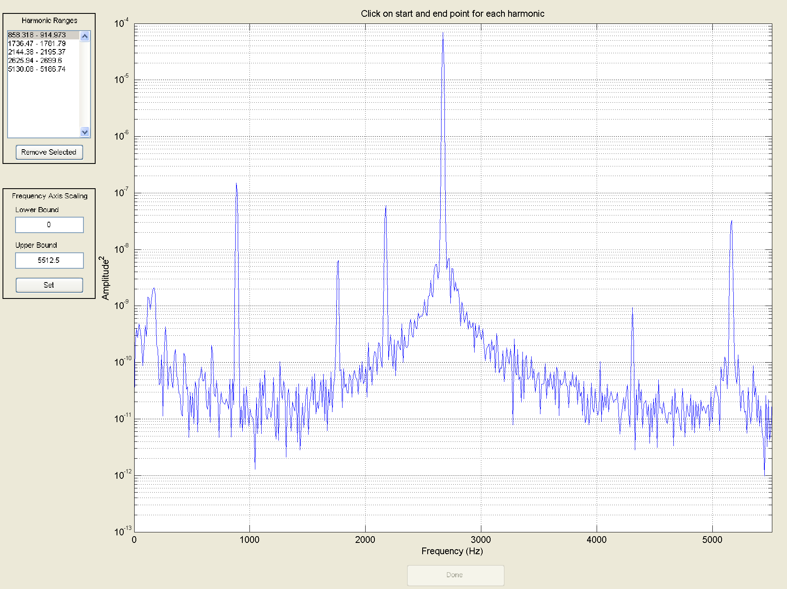
On the Node

Slide 11
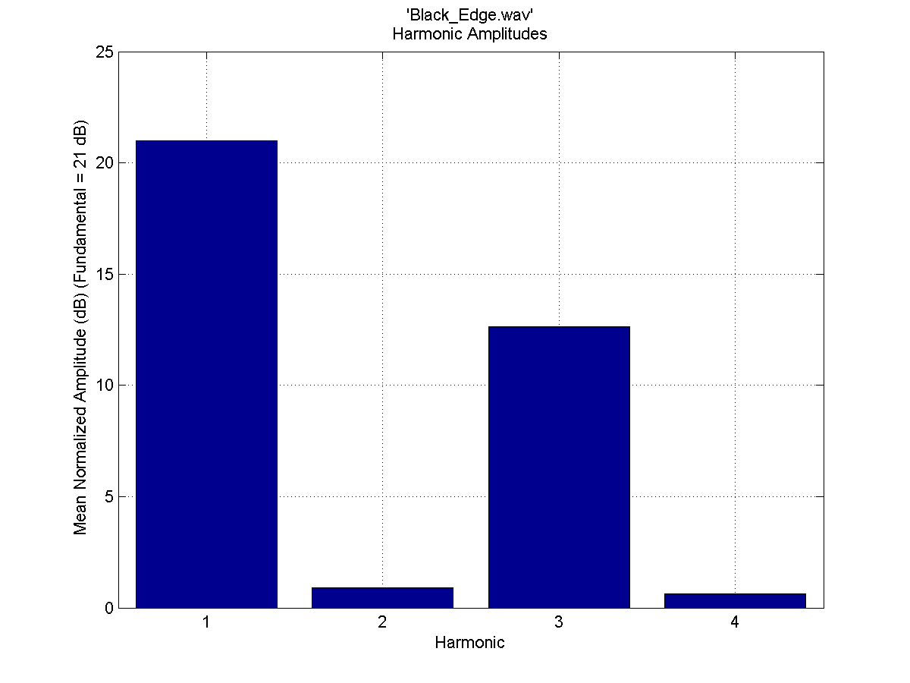
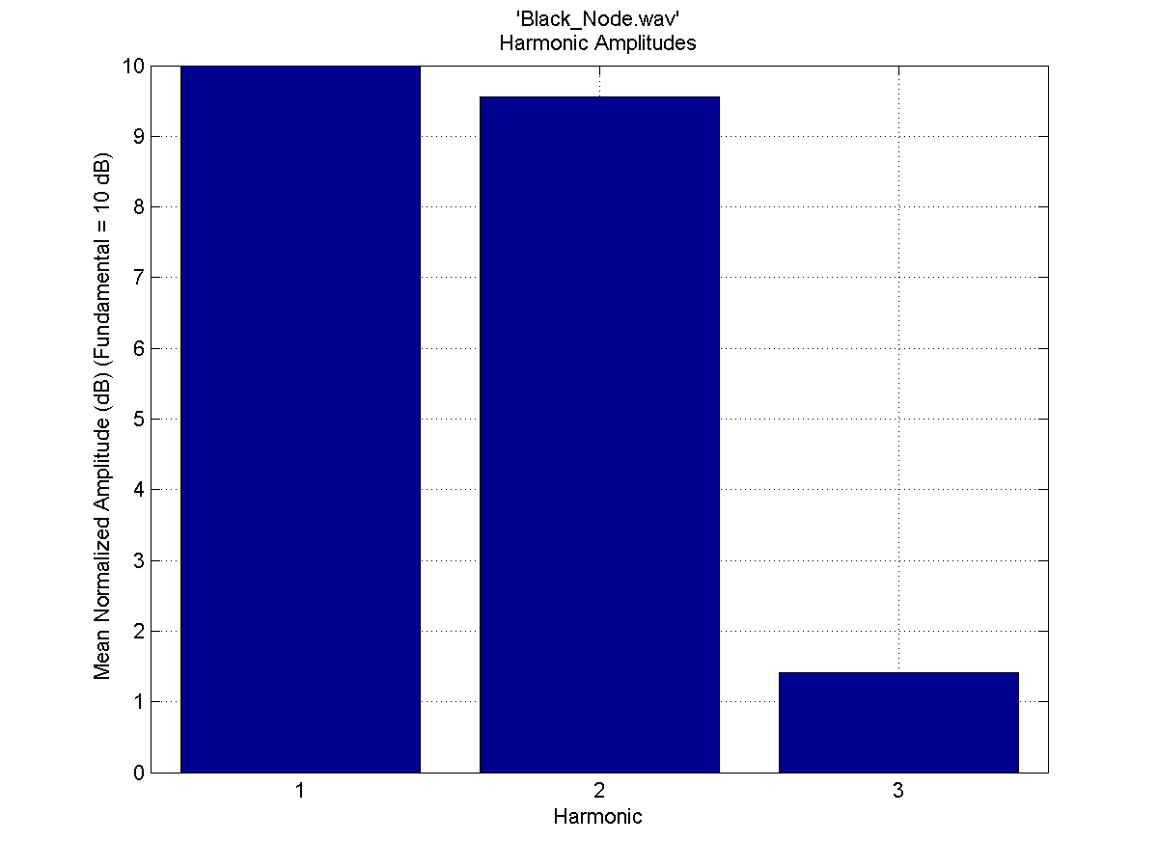
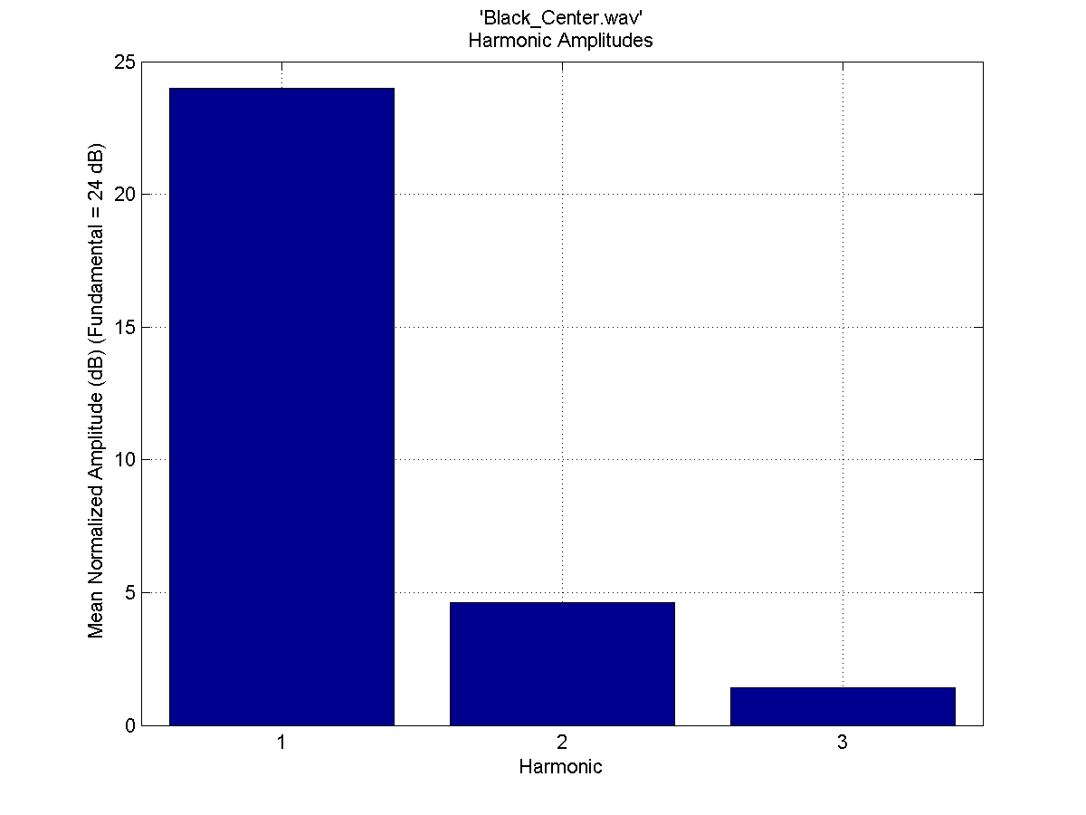
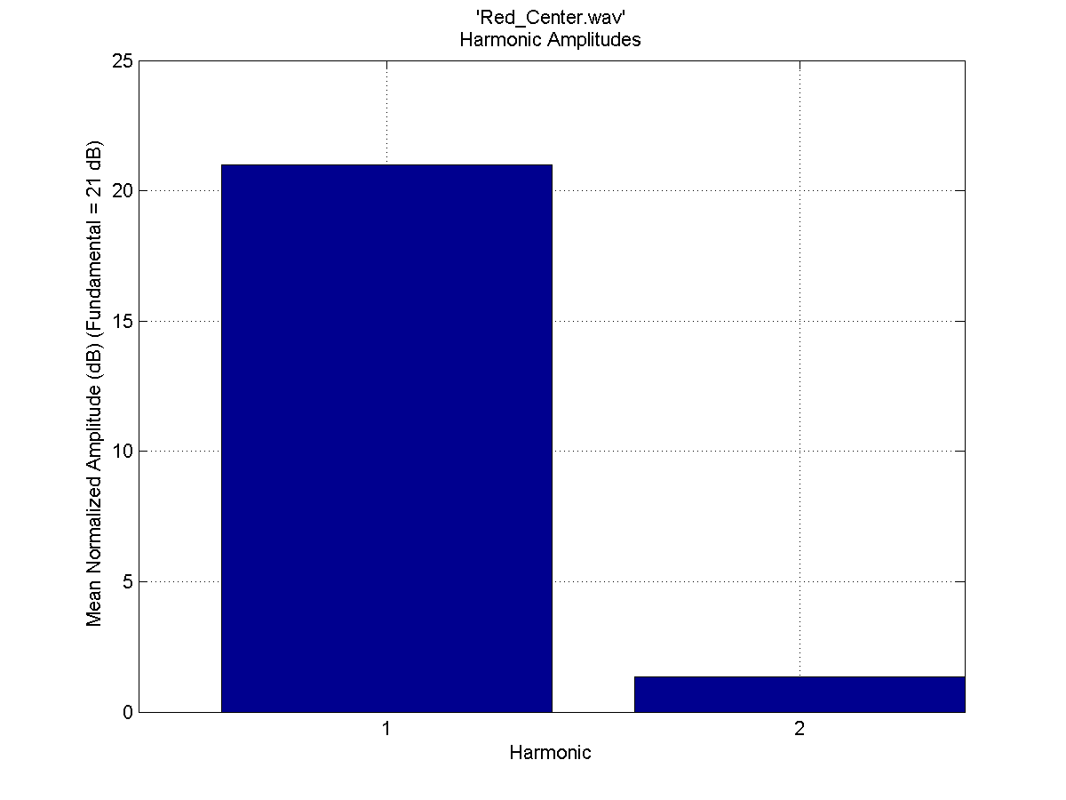
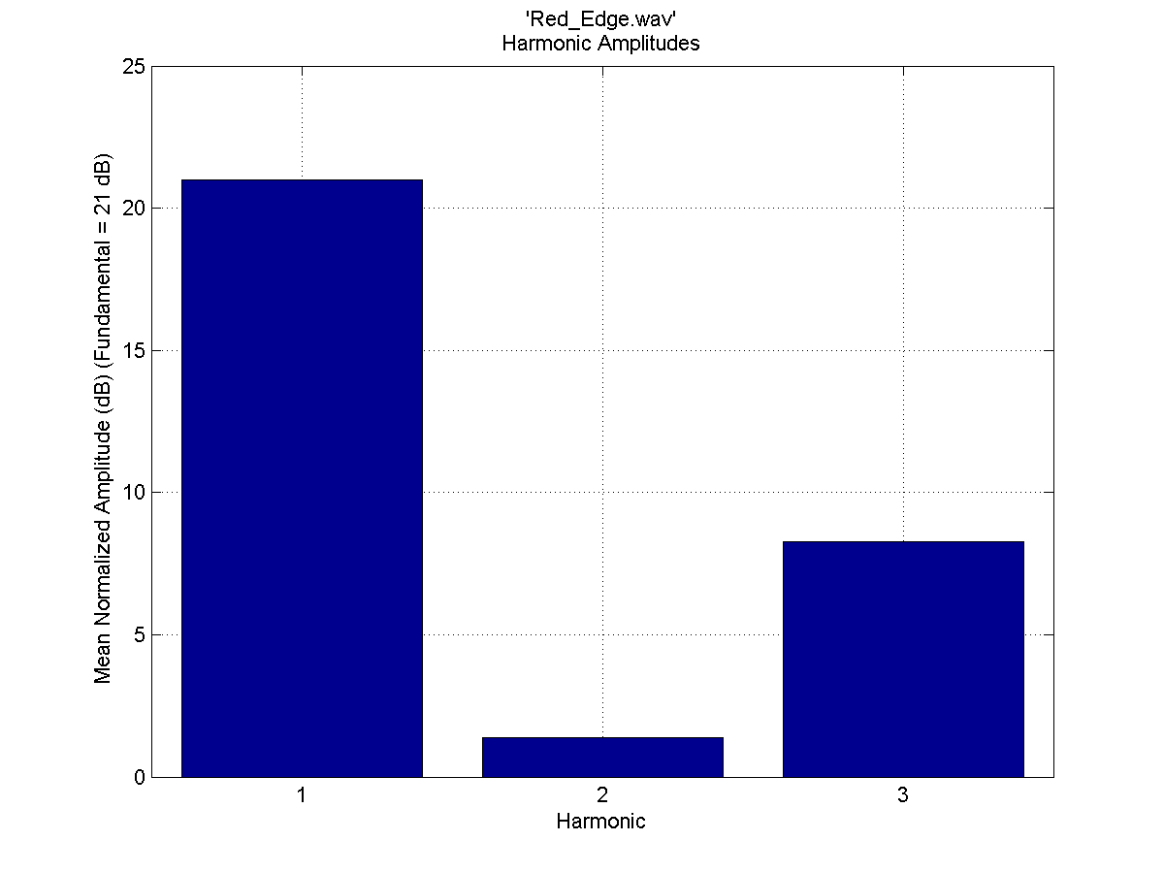
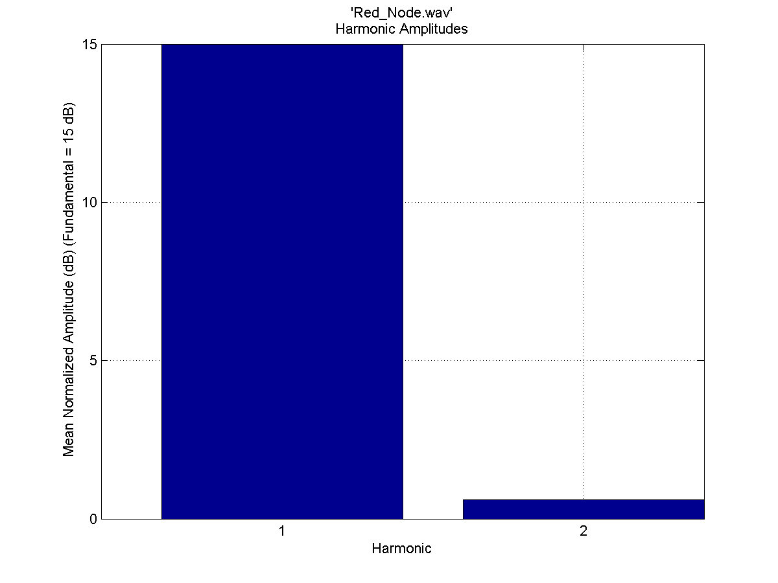
Marimba Harmonics
Instrument | Mallet | Location | # Harmonics | H1 Freq | H2 Freq | H3 Freq | H4 Freq
Marimba | Black | Center | 3 | 221.5 | 665 | 990
Marimba | Black | Edge | 4 | 221.4 | 665 | 885 | 2240
Marimba | Black | Node | 3 | 221.5 | 885.5 | 2210
Marimba | Red | Center | 2 | 221.6 | 664
Marimba | Red | Edge | 3 | 221.4 | 664 | 885.5
Marimba | Red | Node | 2 | 221.5 | 885

Slide 12
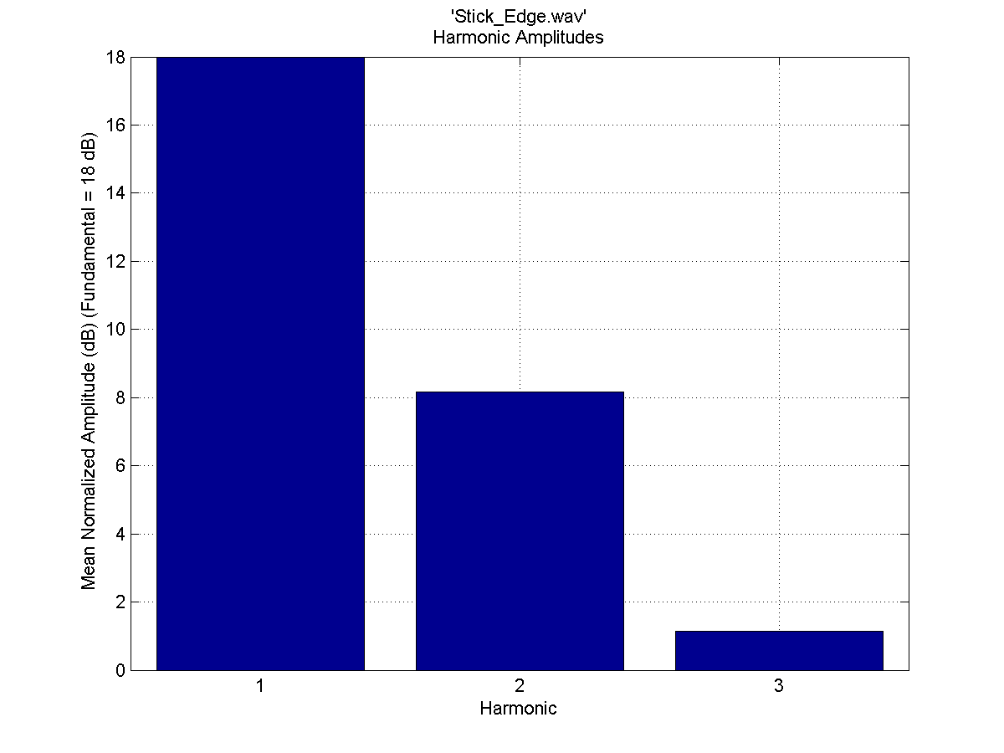
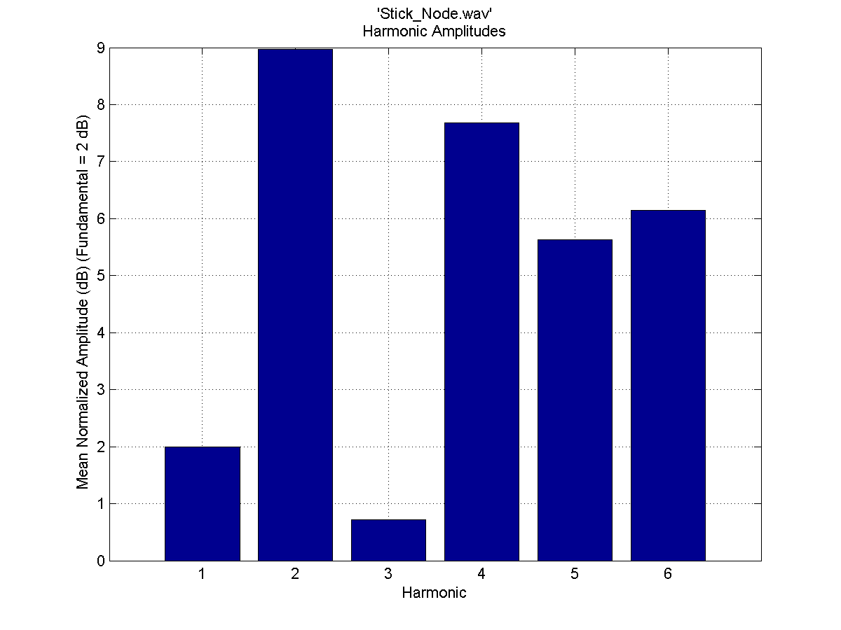
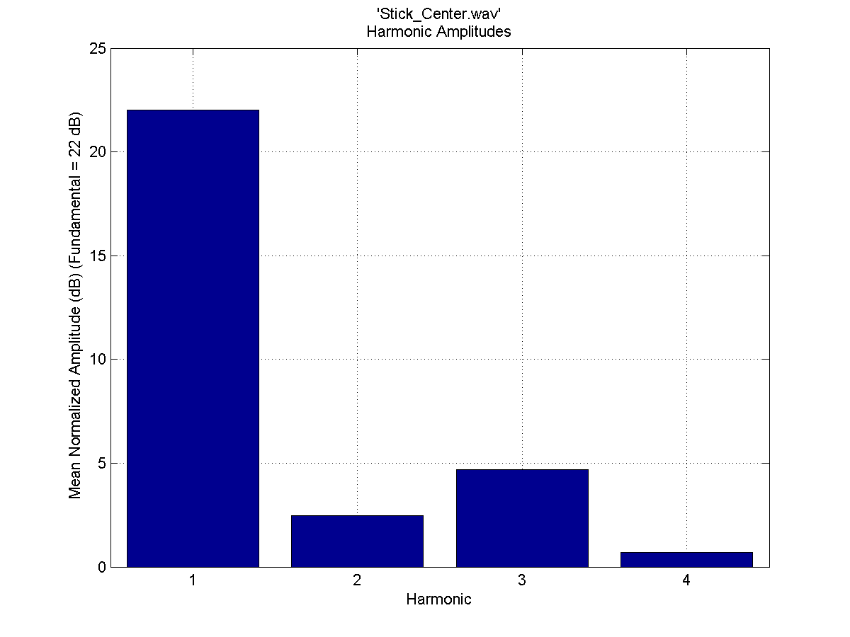
Using a Stick on Marimba
Instrument | Mallet | Location | # Harmonics | H1 Freq | H2 Freq | H3 Freq | H4 Freq | H5 Freq | H6 Freq
Marimba | Stick | Center | 4 | 222 | 2100 | 2210 | 2400
Marimba | Stick | Edge | 3 | 221.5 | 885 | 2205
Marimba | Stick | Node | 6 | 221 | 855.3 | 2064 | 2210 | 3900 | 4460
Notes:
Use wind in bamboo grove for sound clip?

Slide 13
Conclusion
Sounds made of harmonics
Relative phase has no apparent pattern in mallet percussion
Vibraphone very simple sound when wet, more complicated when dry
Soft mallets on marimba and vibes induce sounds with less harmonics
Xylophone has different sounds depending on striking location
Harder mallets on marimba produce trends in harmonics similar to xylophone

Slide 14
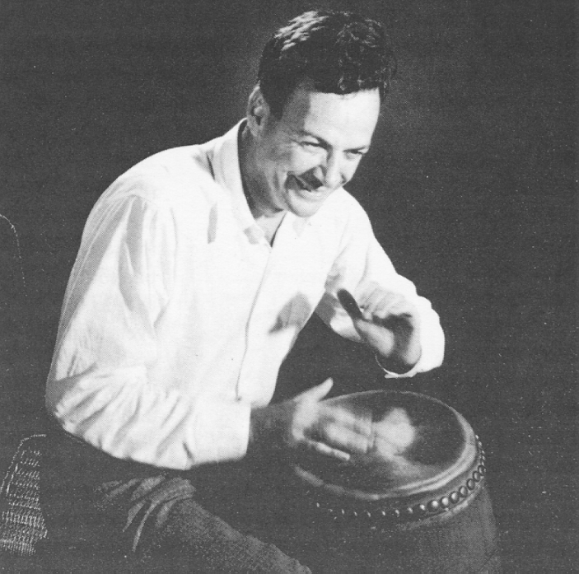
Thanks to:
Professor Steve Errede
Adam Watts
Dan Carson
3M
Richard Feynman playing conga; photo courtesy of physics.miami.edu

